Slide 1
Case Study EDA
Sid Swarupananda
Sean mcWhirter

Slide 2
MSDS 6306: Doing Data Science - Case Study 01 Description
The Beers dataset contains a list of 2410 US craft beers and Breweries dataset contains 558 US breweries. The datasets descriptions are as follows.
Beers.csv:
Name: Name of the beer.
Beer_ID: Unique identifier of the beer.
ABV: Alcohol by volume of the beer.
IBU: International Bitterness Units of the beer.
Brewery_ID: Brewery id associated with the beer.
Style: Style of the beer.
Ounces: Ounces of beer.
Breweries.csv:
Brew_ID: Unique identifier of the brewery.
Name: Name of the brewery.
City: City where the brewery is located.
State: U.S. State where the brewery is located.

Slide 3
MSDS 6306: Doing Data Science - Case Study 01 Analysis
Breweries per state
Median alcohol content per state
Median international bitterness per state
Beers with highest Alcohol by Volume (ABV) and International Bitterness Unit (IBU)
Summary stats of Alcohol by Volume(ABV)
Analysis of relationship between Alcohol by Volume (ABV) and International Bitterness Unit (IBU)

Slide 4
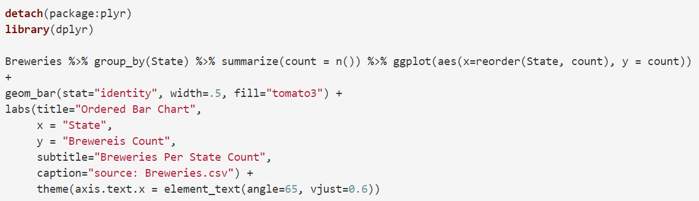
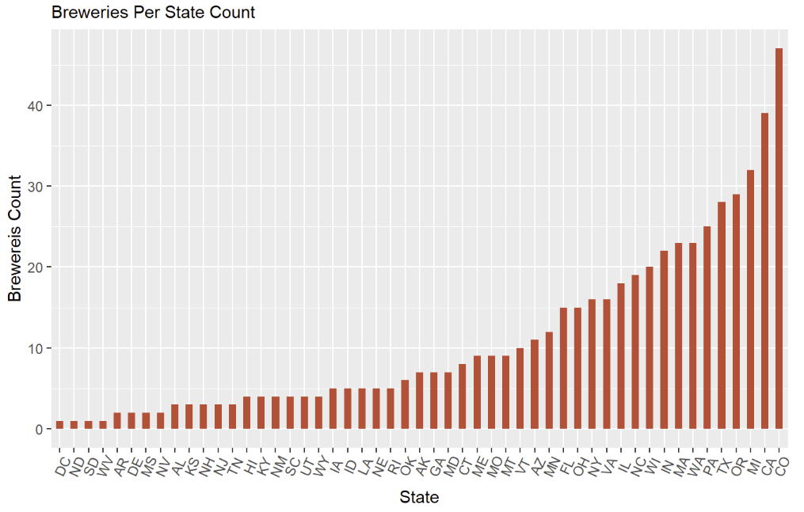
How many breweries are present in each state?

Slide 5
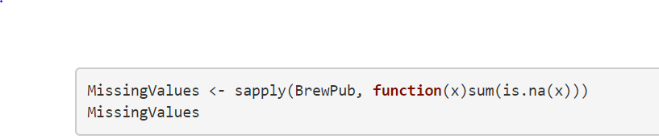
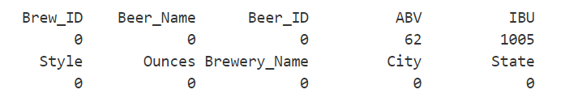
Address the missing values in each column
ABV and IBU are the only columns with missing values. However, since we have a high number of observations, we should be able to omit the missing values and still be able to determine any significant insights.

Slide 6
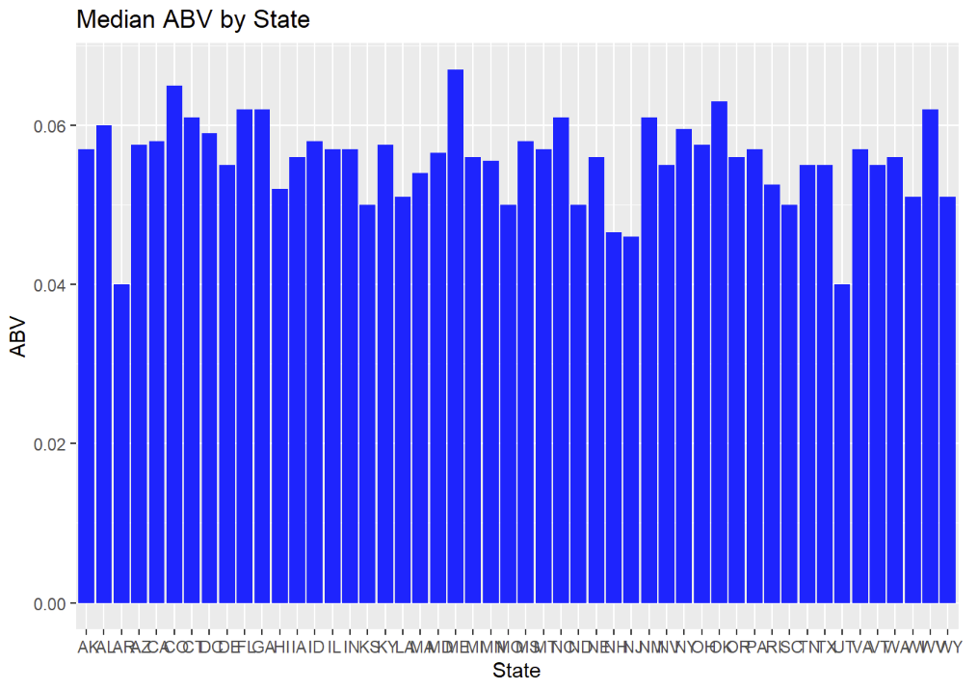
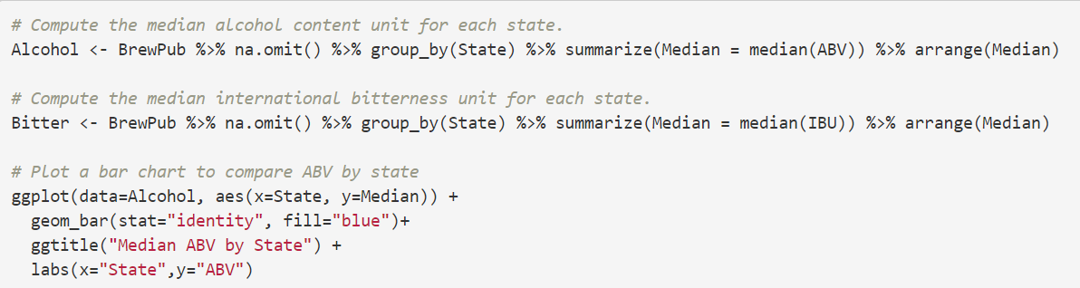
Compute the median alcohol content and international bitterness unit for each state. Plot a bar chart to compare

Slide 7
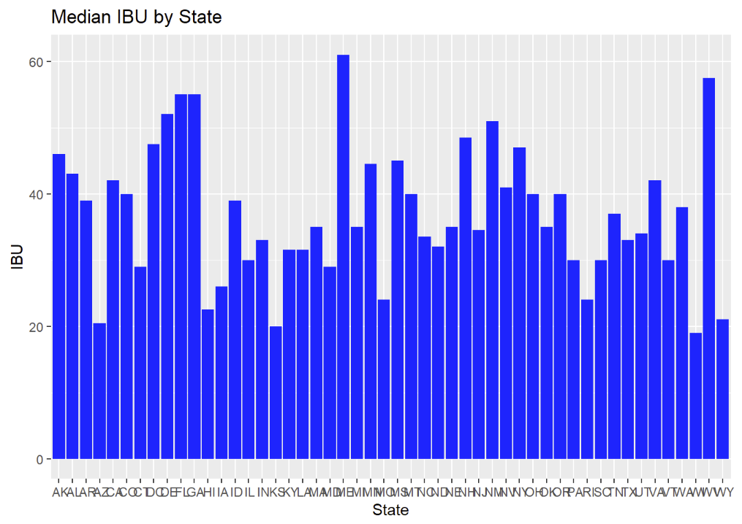
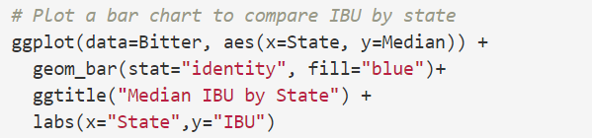
Median IBU by State

Slide 8
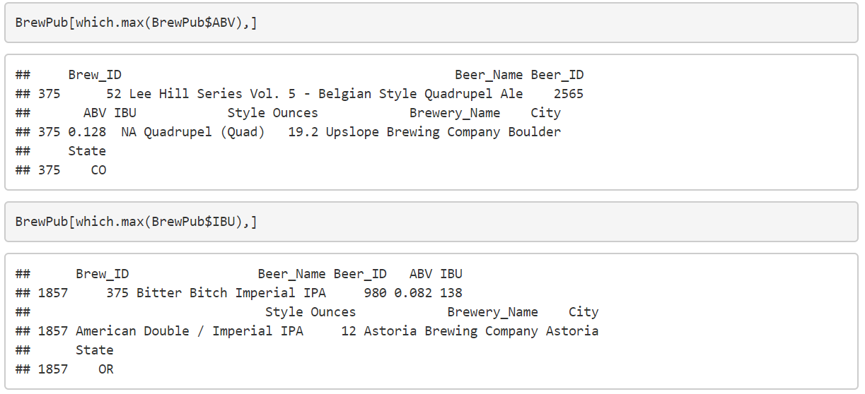
Which state has the maximum alcoholic (ABV) beer? Which state has the most bitter (IBU) beer?

Slide 9
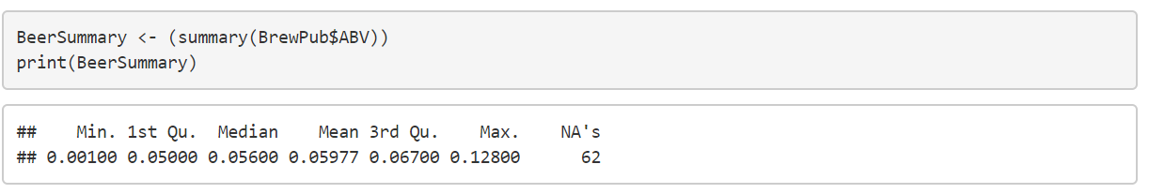
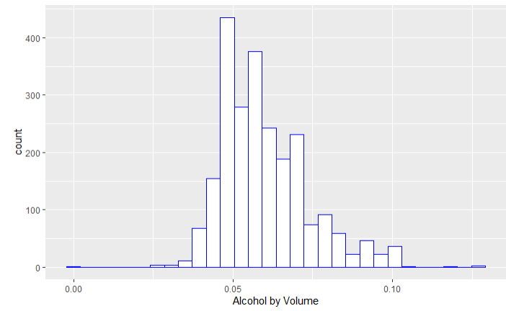
Comment on the summary statistics and distribution of the ABV variable
Looking at a histogram of the data, it seems to be a bit right-skewed. This makes sense because beer is not meant to be a very high ABV drink—the high ABV beers would be more rare.

Slide 10
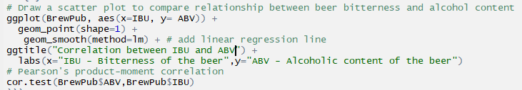
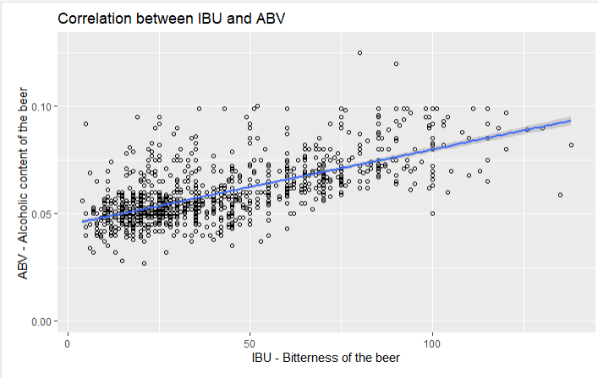
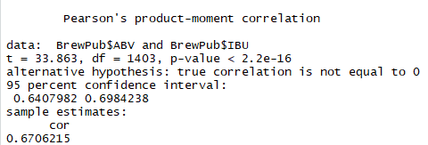
Is there an apparent relationship between the bitterness of the beer and its alcoholic content? Draw a scatter plot.

Slide 11
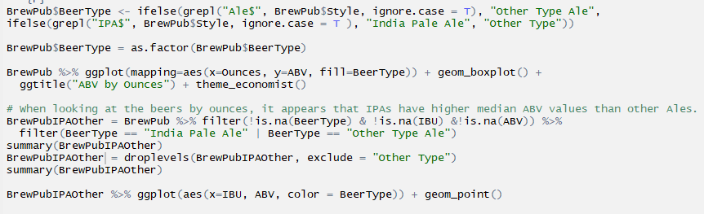
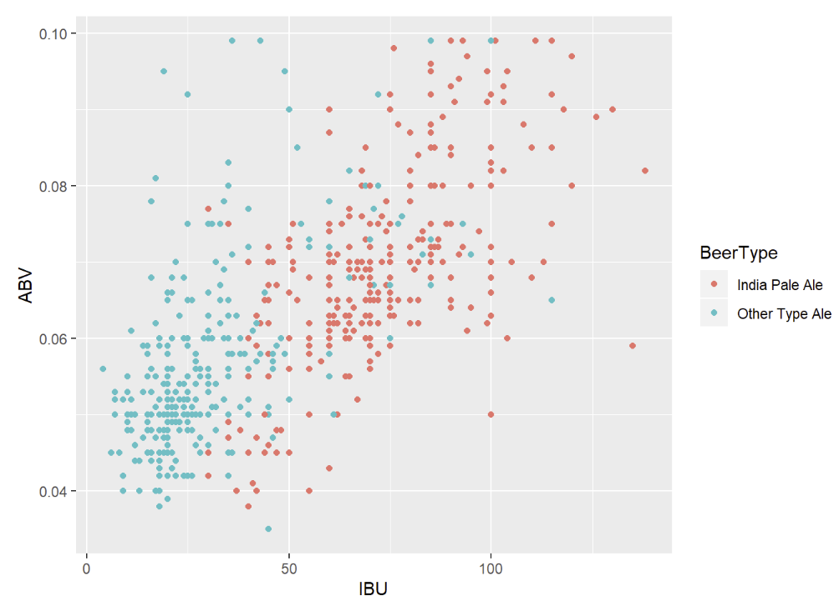
Budweiser would also like to investigate the difference with respect to IBU and ABV between IPAs (India Pale Ales) and other types of Ale (any beer with “Ale” in its name other than IPA).

Slide 12
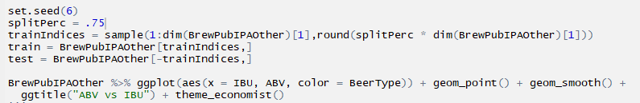
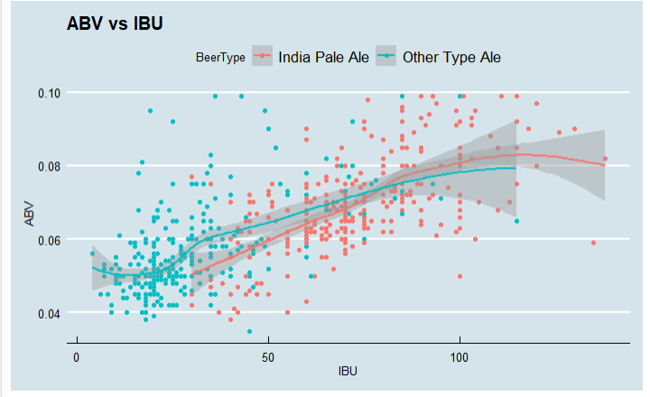
Budweiser would also like to investigate the difference with respect to IBU and ABV between IPAs (India Pale Ales) and other types of Ale (any beer with “Ale” in its name other than IPA).

Slide 13
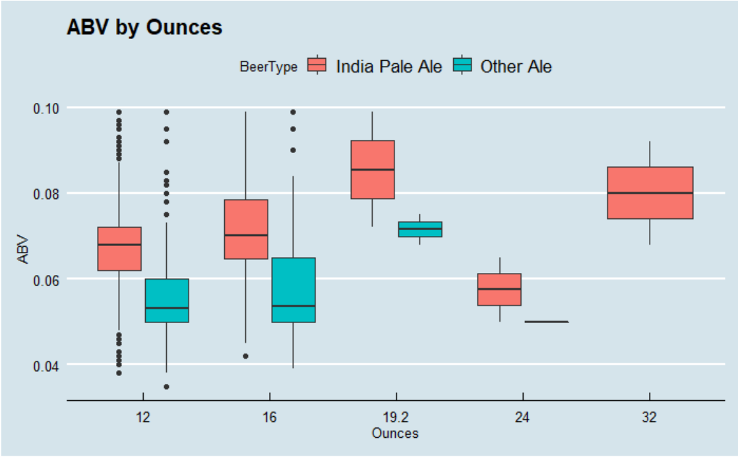
Other Insights
When looking at the beers by ounces, it appears that IPAs have higher median ABV values than other ales.

Slide 14
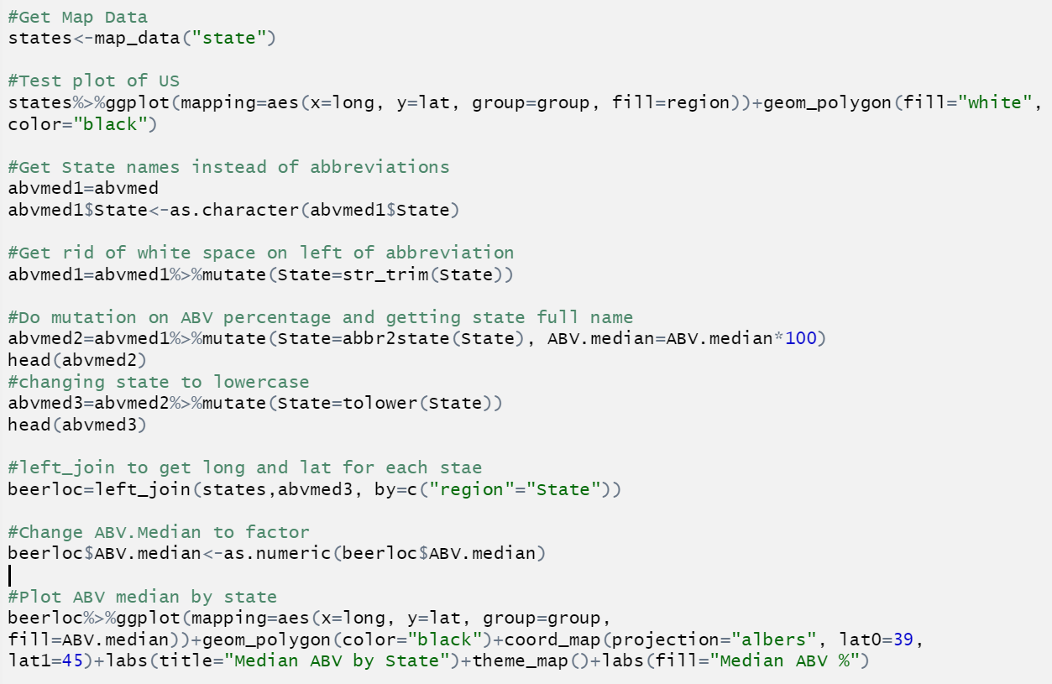
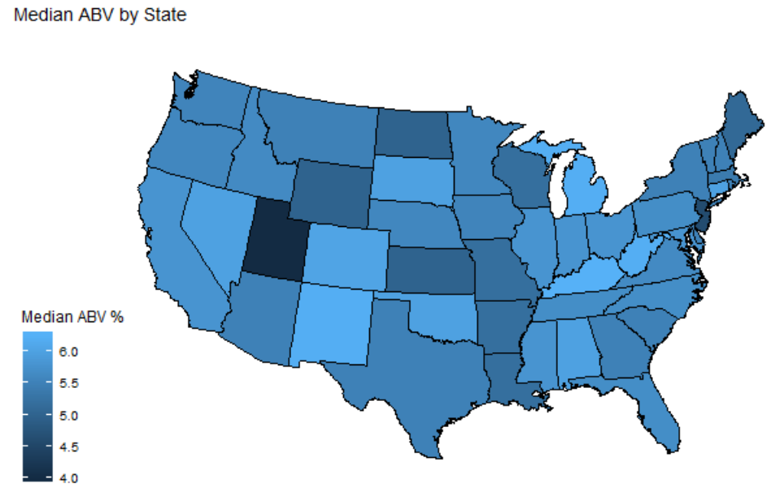
Other Insights

